Slide 1
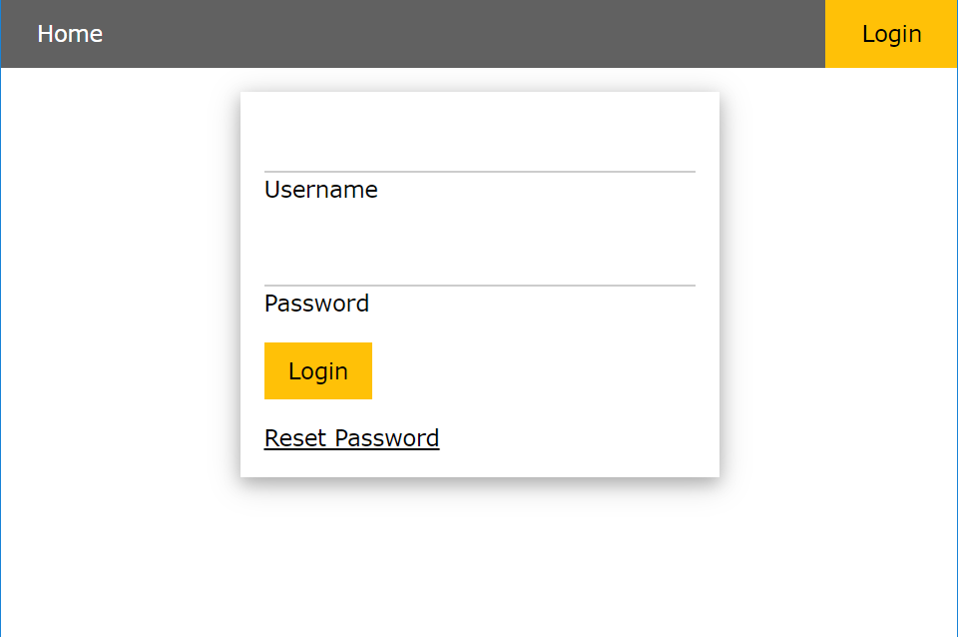
Fuzzer implementation
Rameez Hussain

Slide 2
Outcomes
What is a Fuzzer?
Connection
Implementation
Challenges
Conclusion

Slide 3
What is a Fuzzer?
A could be considered as a program which automatically injects semi-random data into a program and detects bugs.
It could also be considered as a quality assurance technique to find out security loopholes in software and others.
Best for discovering vulnerabilities that can be exploited by:
Buffer overflow
DOS
Cross-site scripting
SQL injections
WHY?
Provide results with little effort
Can reveal bugs or vulnerabilities that were missed
Robustness

Slide 4
Connection
Connecting the DVGM to my development machine which allowed me to test my Fuzzer without developing in the VMware
IP addr command to get the IP address on the VMWare
Start the server by bin/rails server –binding 192.168.231.128
Open up Google Chrome and navigate to http://192.168.231.128:3000/
Up and connected successfully

Slide 5
Implementation
Got the static payloads from the GitHub repository and other resources I found online
I have implemented a Fuzzer that can detect SQL injections for:
Login page of the DVGM
Grades page for the DVGM
Session was created for the login session

Slide 6
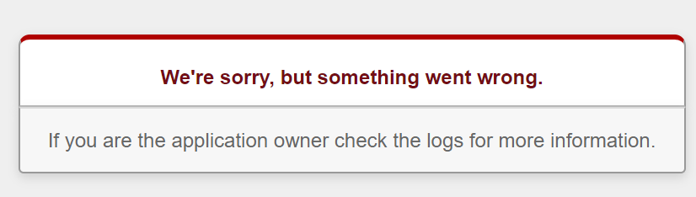
Challenges
Connection
Database
Cross-site scripting

Slide 7
Thank you for listening

